Slide 1
RELATIONAL
ALGEBRA
Dr. Jose Annunziato

Slide 2
Relational Algebra
Created in 1970 by Edgar F. Codd while at IBM
Theoretical foundation for relational database queries, i.e., SQL

Slide 3
Single Table Operators
Select – returns same columns as input table, removes some rows
Project – returns same rows as input table, removes some columns
Sort – returns same input table, rows in different order

Slide 4
Single Table Operators
Rename – returns same table, one column with a different name
Extend – returns same table, additional column with computed value
Groupby – returns table, one row for each group of input records

Slide 5
Two Table Operators
Product – returns table containing all possible combinations of records from input tables
Join – connects tables together. Equivalent to selection of a product
Semijoin – returns table with records from input table1 that match some record in input table2

Slide 6
Two Table Operators
Antijoin – returns table with records from input table1 that do not match records in input table2
Union – returns table with records from both tables
Outer Join – returns table with records of join, and with non-matching records padded with nulls

Slide 7
QUERIES
Dr. Jose Annunziato

Slide 8
Select
Select takes a table and a predicate
Returns subset of rows that satisfy predicate
"Students who graduated in 2004"
Q1 = select(STUDENT, GradYear=2004)
Q1 = σ_{GradYear=2004}(STUDENT)

Slide 9
Combine Terms with Boolean Operators
"Students who graduated in 2004
with a major of 10 or 20"
Q2 = select(STUDENT, GradYear=2004 AND MajorId=10)
Q2 = σ_{GradYear=2004^MajorId=10}(STUDENT)
Q2 = select(STUDENT, GradYear=2004
AND (MajorId=10 OR MajorId=20))

Slide 10
Nested Queries
Output of one query can be input of another query
Example: Students who graduated in 2004 with a major of 10 or 20
Q3 = select(select(STUDENT, GradYear=2004),
MajorId=10 or MajorId=20)
OR
Q1 = select(STUDENT, GradYear=2004)
Q4 = select(Q1, MajorId=10 or MajorId=20)

Slide 11
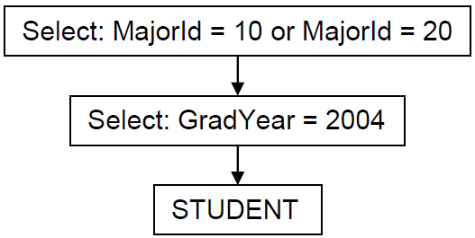
Query Tree
Express queries graphically using a query tree
Q3 = select(select(STUDENT, GradYear=2004),
MajorId=10 or MajorId=20)
Can be represented graphically as

Slide 12
Projecting
Project returns
a subset of columns
same records as input table, but only the argument columns
The following query returns columns SName and GradYear from STUDENT table
Q5 = project(STUDENT, {SName, GradYear})
Q5 = π_{SName,GradYear}(STUDENT)

Slide 13
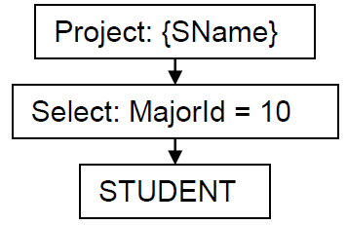
Nest Queries to Combine
Nest output of one query as input to another query
Example: The name of students having major 10
Q6 = project(select(STUDENT, MajorId=10), {SName})
Q6 = π_{SName}(σ_{MajorId=10}(STUDENT))
Graphically:
π_{SName}
σ_{MajorId=10}
STUDENT

Slide 14
Meaningless Queries
The following query is meaningless
Outer query's predicate depends on field not provided by inner query
Q7=select(project(STUDENT,{SName}),MajorId=10)
Nested query returns column SName
Predicate of outer query expects MajorId column

Slide 15
Sort
Sorts result sets from table based on field names
Following query returns STUDENT records sorted by GradYear and then SName
That is, sorts first by GradYear, then if students have same GradYear, they are sorted by SName
Q8 = sort(STUDENT, [GradYear, SName])
Only sorts results, not the actual records on the table

Slide 16
Rename
Rename operator renames a field from a table
Following query returns all records from Q6, and renames field SName to CSMajors
Q9 = rename(Q6, SName, CSMajors)
Useful for
Joins and products where fields must appear twice
Display purposes

Slide 17
Extend
Extend adds a new field whose value can be calculated from other fields
Following query calculates graduation year from year of foundation
Q10 = extend(STUDENT, GradYear - 1863, GradClass)
Expressions can contain arithmetic functions, constant/literal number, string, date

Slide 18
GROUP BY
Dr. Jose Annunziato

Slide 19
Group By
Extend combines fields in same record horizontally
GroupBy combines fields several records vertically
Records are grouped if fields have same values
Fields from grouped records are aggregated
Syntax
groupby(TABLE, {group, fields}, {aggegate, funcs})

Slide 20
GroupBy - Example
Following query groups students by MajorId
GradYear aggregated to min and max GradYear
Q12 = groupby(STUDENT, {MajorId},
{Min(GradYear), Max(GradYear)})

Slide 21
STUDENT
SId | SName | GradYear | MajorId
1 | joe | 2004 | 10
2 | amy | 2004 | 20
3 | max | 2005 | 10
4 | sue | 2005 | 20
5 | bob | 2003 | 30
6 | kim | 2001 | 20
7 | art | 2004 | 30
8 | pat | 2001 | 20
9 | lee | 2004 | 10

Slide 22
STUDENT
SId | SName | GradYear | MajorId
1 | joe | 2004 | 10
9 | lee | 2004 | 10
3 | max | 2005 | 10
2 | amy | 2004 | 20
4 | sue | 2005 | 20
6 | kim | 2001 | 20
8 | pat | 2001 | 20
5 | bob | 2003 | 30
7 | art | 2004 | 30

Slide 23
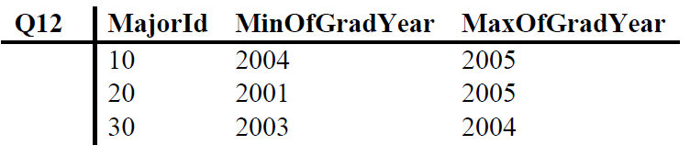
GroupBy - Example
Following query groups students by MajorId
GradYear aggregated to min and max GradYear
Q12 = groupby(STUDENT, {MajorId},
{Min(GradYear), Max(GradYear)})

Slide 24
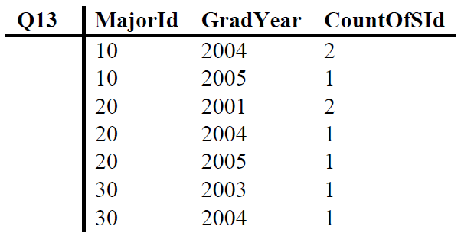
Multiple Grouping Fields
Grouped if same values for all grouping fields
"Number of students in each major, per graduation year"
Q13 = groupby(STUDENT, {MajorId,GradYear}, {Count(SId)})

Slide 25
Multiple Grouping Fields
Grouped if same values for all grouping fields
"Number of students in each major, per graduation year"
Q13 = groupby(STUDENT, {MajorId,GradYear}, {Count(SId)})
2
2

Slide 26
STUDENT
SId | SName | GradYear | MajorId
1 | joe | 2004 | 10
9 | lee | 2004 | 10
3 | max | 2005 | 10
2 | amy | 2004 | 20
4 | sue | 2005 | 20
6 | kim | 2001 | 20
8 | pat | 2001 | 20
5 | bob | 2003 | 30
7 | art | 2004 | 30
2
2
1

Slide 27
Grouping Whole Table
If no grouping field, then whole table is grouped
Example: Earliest graduation year of any student
Q14 = groupby(STUDENT, {}, {Min(GradYear)} )
MinGradYear
2001

Slide 28
No Aggregate Functions
If no aggregate functions are provided, then result just lists distinct grouping fields
Q15 = groupby(STUDENT, {MajorId}, {} )

Slide 29
Distinct Aggregate Functions
Aggregate functions have two versions:
Count CountDistinct
Sum SumDistinct etc…
"Number of students having a major"
Q16 = groupby(STUDENT, {}, {Count(MajId)} )
"Number of different majors"
Q17=groupby(STUDENT, {},{CountDistinct(MajId)})

Slide 30
Not Counting Nulls
Null values are ignored
If table has no nulls, doesn’t matter which field we count
If table can have nulls, then careful which field is counted
Count primary keys if counting number of records in groups, since they can't be null

Slide 31
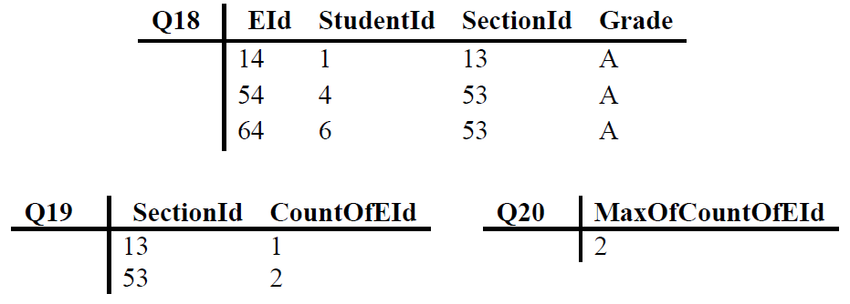
Combining GroupBy (1/2)
Consider question: "Most “A” grades in any section?"
Q18 = select(ENROLL, Grade='A') -- enrollments with 'A'
Q19 = groupby(Q18, {SectionId}, {Count(EId)} ) -- count
Q20 = groupby(Q19, {}, {Max(CountOfEId)} ) -- count

Slide 32
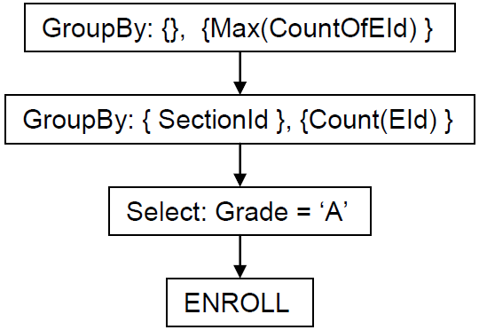
Combining GroupBy (2/2)
Q20a = groupby(groupby(select(ENROLL,
Grade='A'), {SectionId}, {Count(EId)} ), {},
{Max(CountOfEId)} )
Q20
Q19
Q18

Slide 33
JOINING TABLES
Dr. Jose Annunziato

Slide 34
Product
Product combines multiple tables
Returns combinations of records from both tables
Example: Combinations from STUDENT and DEPT
Syntax: product ( table1, table2 )
Q22 = product(STUDENT, DEPT)
Consider tables A and B
A x B
A | B
a1 | b1
a1 | b2
a2 | b1
a2 | b2
A
a1
a2
B
b1
b2

Slide 35
Consider Tables STUDENT and DEPT
STUDENT
SId | SName | GradYear | MajorId
1 | joe | 2004 | 10
2 | amy | 2004 | 20
3 | max | 2005 | 30
4 | sue | 2005 | 20
5 | bob | 2003 | 30
6 | kim | 2001 | 20
7 | art | 2004 | 30
8 | pat | 2001 | 20
9 | lee | 2004 | 10
DEPT
DId | DName
10 | compsci
20 | math
30 | drama

Slide 36
Product of Tables STUDENT and DEPT
STUDENT X DEPT
SId | SName | GradYear | MajorId | Did | DName
1 | joe | 2004 | 10 | 10 | compsci
2 | amy | 2004 | 20 | 10 | compsci
3 | max | 2005 | 30 | 10 | compsci
1 | joe | 2004 | 10 | 20 | math
2 | amy | 2004 | 20 | 20 | math
3 | max | 2005 | 30 | 20 | math
1 | joe | 2004 | 10 | 30 | drama
2 | amy | 2004 | 20 | 30 | drama
3 | max | 2005 | 30 | 30 | drama

Slide 37
Filtering a Product
"All students and their major departments"
Q23 = select(
product(STUDENT, DEPT),
MajorId=Did)
STUDENT X DEPT
SName | MajorId | Did | DName
joe | 10 | 10 | compsci
amy | 20 | 10 | compsci
max | 30 | 10 | compsci
joe | 10 | 20 | math
amy | 20 | 20 | math
max | 30 | 20 | math
joe | 10 | 30 | drama
amy | 20 | 30 | drama
max | 30 | 30 | drama

Slide 38
Product and Join
Filtering a product is so useful that deserves its own name: join
Joining tables is just selecting a subset of product
join(T1, T2, P) ≡ select(product(T1, T2), P)
join(T1, T2, P) ≡ T1 ⋈_{P} T2
Q23 can be rewritten as
Q24 = join(STUDENT, DEPT, MajorId=DId)
Q24 = STUDENT ⋈_{MajorId=Did} DEPT

Slide 39
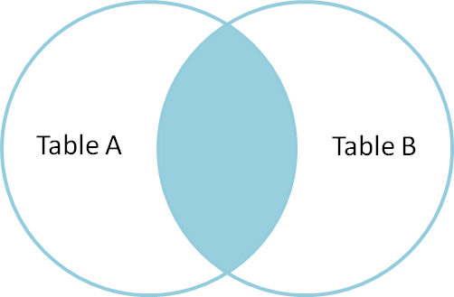
Join Venn Diagram
join(TableA, TableB, SomePredicate)

Slide 40
Join - Example
"Grades that Joe received in his courses during 2004"
Connect tables: STUDENT, ENROLL, and SECTION
Q25 = select(STUDENT, SName='joe')
Q26 = join(Q25, ENROLL, Sid=StudentId)
Q27 = select(SECTION, YearOffered=2004)
Q28 = join(Q26, Q27, SectionId=SectId)
Q29 = project(Q28, {Grade})

Slide 41
Grades Joe Received in Courses in 2004
Q29
Project : {Grade}
Q28
Join : SectId = SectionId
Q26
Q27
Join : SId=StudentId
Select : YearOffered=2004
Q25
Select : SName='joe'
ENROLL
SECTION
STUDENT

Slide 42
An alternative version of Q25
project(
select(STUDENT, SName='Joe'),
{Sid})

Slide 43
Another Join Example
Consider tables Employee and Dept
The join of Employee and Dept on DeptName:
Employee
Name | EmpId | DeptName
Harry | 3415 | Finance
Sally | 2241 | Sales
George | 3401 | Finance
Harriet | 2202 | Sales
Dept
DeptName | Manager
Finance | George
Sales | Harriet
Production | Charles
Name | EmpId | DeptName | Manager
Harry | 3415 | Finance | George
Sally | 2241 | Sales | Harriet
George | 3401 | Finance | George
Harriet | 2202 | Sales | Harriet

Slide 44
JOINING GROUPS
Dr. Jose Annunziato

Slide 45
Recall Most As in Any Section?
Q18 = select(ENROLL, Grade='A')
Q19 = groupby(Q18, {SectionId}, {Count(EId)} )
Q20 = groupby(Q19, {}, {Max(CountOfEId)} )

Slide 46
Which Section Has Most As?
Additional question:
"Which section has most As?"
Solution: join the maximum value from Q20 to the section information of Q19
Q30=join(Q19,Q20, CountOfEId=MaxOfCountOfEId)
Q31=join(SECTION, Q30, SectId=SectionId)

Slide 47
Equijoins & Relationship Joins
Equijoins predicates two fields from two tables
Most common
Relationship joins predicates
primary key of table1
with foreign key of table2

Slide 48
Equijoins & Relationship Joins
Project : {Grade}
Select : YearOffered = GradYear
Join : Section = SectId
Join : SId = StudentId
SECTION
Select : SName = 'joe'
ENROLL
STUDENT

Slide 49
Self Join
"Students that have same major as Joe"
Q32 = project(select(STUDENT, SName='joe'), {MajorId})
Q33 = rename(Q32, MajorId, JoesMajorId)
Q34 = join(Q33, STUDENT, JoesMajorId=MajorId)
Here we had to do a self join, a table joined with itself

Slide 50
SEMIJOINS, ANTIJOINS & OUTER JOINS
Dr. Jose Annunziato

Slide 51
Semijoin
Recall Q24: pairs STUDENT records with matching DEPT records
Q24 = join(STUDENT, DEPT, MajorId=DId)
But what if we want those records that have a match, not the actual combining of the tables, use semijoin

Slide 52
Semijoin - Example
"The departments that have at least one student in their major"
Q35 = semijoin(DEPT, STUDENT, DId=MajorId)
Return records in DEPT where there exist a matching STUDENT record, but not the students

Slide 53
Semijoins as Joins
Semijoins can be implemented as plain joins
Q36 = join(DEPT, STUDENT, DId=MajorId)
Q37 = groupby(Q36, {DId, DName}, {})

Slide 54
Example: Einstein's Pupils
"What students have taken a course
with Einstein"
Q38 = select(SECTION, Prof='einstein')
Q39 = semijoin(ENROLL, Q38, SectionId=SectId)
Q40 = semijoin(STUDENT, Q39, SId=StudentId)

Slide 55
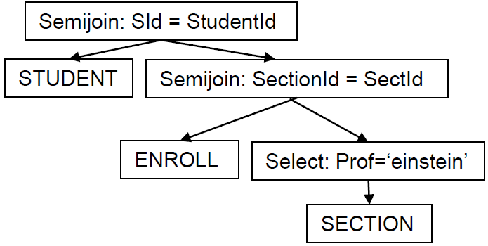
Example: Einstein's Pupils
Q40
Q39
Q38

Slide 56
Example: Regular Join Vs Semijoin
Consider tables Employee and Dept
The Join on the DeptName:
Employee
Name | EmpId | DeptName
Harry | 3415 | Finance
Sally | 2241 | Sales
George | 3401 | Finance
Harriet | 2202 | Production
Dept
DeptName | Manager
Sales | Bob
Sales | Thomas
Production | Katie
Production | Mark
Name | EmpId | DeptName | Manager
Sally | 2241 | Sales | Bob
Sally | 2241 | Sales | Thomas
Harriet | 2202 | Production | Katie
Harriet | 2202 | Production | Mark

Slide 57
Example: Regular Join Vs Semijoin
Consider tables Employee and Dept
The Semijoin on the DeptName:
Employee
Name | EmpId | DeptName
Harry | 3415 | Finance
Sally | 2241 | Sales
George | 3401 | Finance
Harriet | 2202 | Production
Dept
DeptName | Manager
Sales | Bob
Sales | Thomas
Production | Katie
Production | Mark
Name | EmpId | DeptName
Sally | 2241 | Sales
Harriet | 2202 | Production

Slide 58
Antijoin
Semijoin retrieves records that HAVE a match
Anitjoin retrieves records that DON’T HAVE a match
Exactly the opposite
"Departments that have no student majors"
Q41 = antijoin(DEPT, STUDENT, DId=MajorId)
"The departments with at least one student"
Q35 = semijoin(DEPT, STUDENT, DId=MajorId)

Slide 59
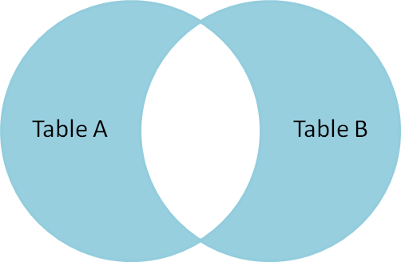
AntijoinVenn Diagram
antijoin(TableA, TableB, SomePredicate)

Slide 60
Antijoin - Example 1
"Sections where nobody received an F"
Q42 = select(ENROLL, Grade='F')
Q43 = antijoin(SECTION, Q42, SectionId=SectId)

Slide 61
Antijoin - Example 2
Consider the Employee and Dept tables
Antijoin Employee with Dept on DeptName
Employee
Name | EmpId | DeptName
Harry | 3415 | Finance
Sally | 2241 | Sales
George | 3401 | Finance
Harriet | 2202 | Production
Dept
DeptName | Manager
Sales | Bob
Sales | Thomas
Production | Katie
Production | Mark
Name | EmpId | DeptName
Harry | 3415 | Finance
George | 3401 | Finance

Slide 62
Antijoin - Example 3
"Professors who have never given a grade of F"
Q44 = select(ENROLL, Grade='F')
Q45 = semijoin(SECTION, Q44, SectionId=SectId)
Q46 = rename(Q45, Prof, BadProf)
Q47 = antijoin(SECTION, Q46, Prof=BadProf)
Q48 = groupby(Q47, {Prof}, {})

Slide 63
Antijoin - Example 4
"Professors who gave an F in every section they taught"
Q49 = rename(Q43, Prof, BadProf)
Q50 = antijoin(SECTION, Q49, Prof = BadProf)
Q51 = groupby(Q50, {Prof}, {})

Slide 64
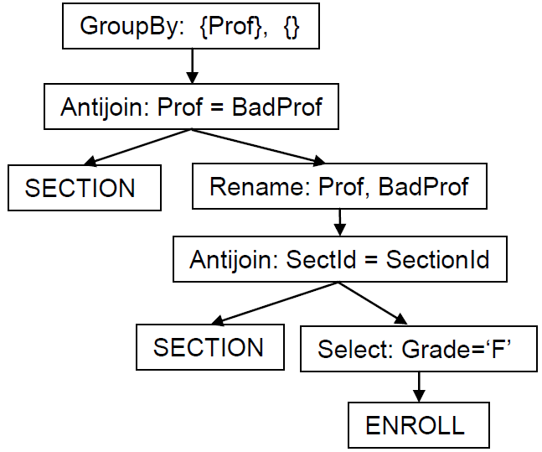
Antijoin - Example 4
Q51
Q50
Q49
Q43
Q42

Slide 65
Outer Join
When joining STUDENT and ENROLL, only registered users appear
What about those who have not yet registered with no matches
Outer Join retrieves the missing students
Q55 = outerjoin(STUDENT, ENROLL, SId=StudentId)
Basically joins normally plus non matching records from either or both tables

Slide 66
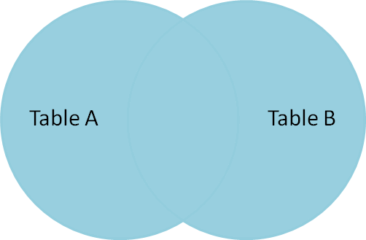
Outer Join Venn Diagram
outerjoin(TableA, TableB, SomePredicate)

Slide 67
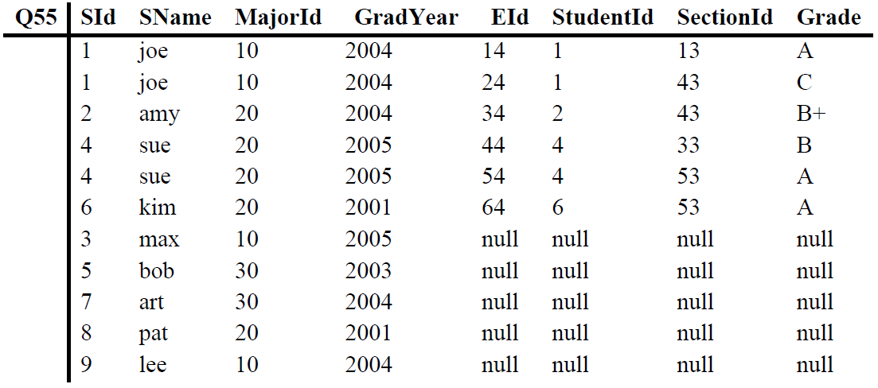
Found Students

Slide 68
Outer Join - Example 1
"Counting the number of enrollments for each student that has taken at least one course"
Q56 = groupby(ENROLL, {StudentId}, {count(EId)} )

Slide 69
Outer Join - Example 2
"Counting the number of enrollments for all students"
Q57 = outerjoin(STUDENT, ENROLL, Sid=StudentId)
Q58 = groupby(Q57, {SId}, {count(EId)} )

Slide 70
Union
Returns records from both tables with no duplicates
Input tables must have same schema
Combining students and professors into single PERSON
Q52 = rename(project(STUDENT, {SName}), SName, Person)
Q53 = rename(project(SECTION, {Prof}), Prof, Person)
Q54 = union(Q52, Q53)

Slide 71
Union - Example
Consider the following 2 tables
Table1: Table2: Union:
Field1 | Field2
A | 1
B | 2
D | 3
F | 4
E | 5
Field1 | Field2
A | 1
C | 2
D | 3
E | 4
Field1 | Field2
A | 1
B | 2
C | 2
D | 3
E | 5
F | 4
E | 4

Slide 72
Symbols
Operator | Symbol | HTML | Unicode
Selection | σ | &xi; | &#x03c3;
Projection | π | &pi; | &#x03c0;
Extension | ξ | &sigma; | &#x3a3;
Rename | ρ | &rho; | &#x03c1;
Product | × | &times; | &#x0215;
Join | ⋈ |  | &#x2a1d;
Left Join |  |  | &#x27d5;
Right Join |  |  | &#x27d6;

Slide 73
Symbols
Operator | Symbol | HTML | Unicode
Full Outer Join | ⟗ |  | &#x27d7;
Semijoin | ⋉ |  | &#x22c9;
Antijoin | ▷ |  | &#x25b7;
Union | ∪ | &cup; | &#x222a;
Intersection | ∩ | &cap; | &#x2229;
Difference | – | &ndash; | &#x2013;
Partition | ψ | &psi; | &#x03c8;

Slide 74
EXAMPLE QUERIES
Dr. Jose Annunziato

Slide 75
Consider the following schema
professor(profname, deptname)
department(deptname, building)
committee(commname, profname)

Slide 76
Example Query
"Find all the professors who are in any one of the committees that Professor Smith is in"
Select all committees where Smith is a member
Q1 = select(committee, profname='Smith')
Only keep the committee name
Q2 = project(commname, Q1)

Slide 77
Example Query
Only keep the committee name
Q2 = project(commname, Q1)
Extract all the professors in those committees
Q3 = join(committee, Q2, commname)
Keep professors who are not Smith
project(profname, select(Q3,profname!='Smith'))

Slide 78
Using Symbols
"Find all the professors who are in any one of the committees that Professor Smith is in"
Select all committees where Smith is a member
Q1 = σ_{profname='Smith'}(committee)
Only keep the committee name
Q2 = π_{commname}(Q1)

Slide 79
Using Symbols
Extract all the professors in those committees
Q3 = committee ⋈ _{commname} Q2
Keep professors who are not Smith
π_{profname}(σ_{profname!='Smith'}(Q3))

Slide 80
Another Example
Consider the following schema
suppliers(sid, sname, status, city)
part(pid, pname, color, weight, city)
job(jid, jname, city)
partsupplier(sid, pid, jid, qty)

Slide 81
Example Query
"Find all suppliers with status '30' that supply part 'P2'. For each supplier, output the name and the quantity of part 'P2' they supply"
Select part P2
Q1 = select(partsupplier,pid='P2')

Slide 82
Example Query
Grab the supplier with status '30'
Q2 = select(supplier,status='30')
Join Q1 and Q2 on sid
Q2 = join(Q1, Q2, Q1.sid=Q2.sid)
Extract supplier name and quantity
project(Q2, {sname, qty})

Slide 83
Using Symbols
"Find all suppliers with status '30' that supply part 'P2'. For each supplier, output the name and the quantity of part 'P2' they supply"
Select part P2
Q1 = σ_{pid='P2'}(partsupplier)

Slide 84
Using Symbols
Grab the supplier with status '30'
Q2 = σ_{status='30'}(supplier)
Join Q1 and Q2 on sid
Q2 = Q1 ⋈_{Q1.sid=Q2.sid} Q2
Extract supplier name and quantity
π_{sname,qty}(Q2)

Slide 85
Yet Another Example Query
"Find the supplier numbers for all suppliers who either supply a 'Blue' part or supply to a job in 'Athens'"
Select the blue parts
Q1 = select(parts, color='Blue')
Join with partsupplier to get supplier
Q2 = join(Q1, partsupplier, Q1.pid=partsup.pid)

Slide 86
Example Query
Select the parts in Athens
Q3 = select(parts, city='Athens')
Join with partsupplier to get supplier
Q4 = join(Q3, partsupplier, Q3.pid=partsup.pid)
Union
Q2 U Q4

Slide 87
Using Symbols
"Find the supplier numbers for all suppliers who either supply a 'Blue' part or supply to a job in 'Athens'"
Select the blue parts
Q1 = σ_{color='Blue'}(parts)
Join with partsupplier to get supplier
Q2 = Q1 ⋈ _{Q1.pid=partsup.pid} partsupplier

Slide 88
Using Symbols
Select the parts in Athens
Q3 = σ_{city='Athens'}(parts)
Join with partsupplier to get supplier
Q4 = Q3 ⋈ _{Q3.pid=partsup.pid} partsupplier
Union
Q2 U Q4

